Slide 1


ANALYSIS OF AIRBNB – PARIS
GROUP 7

Slide 2
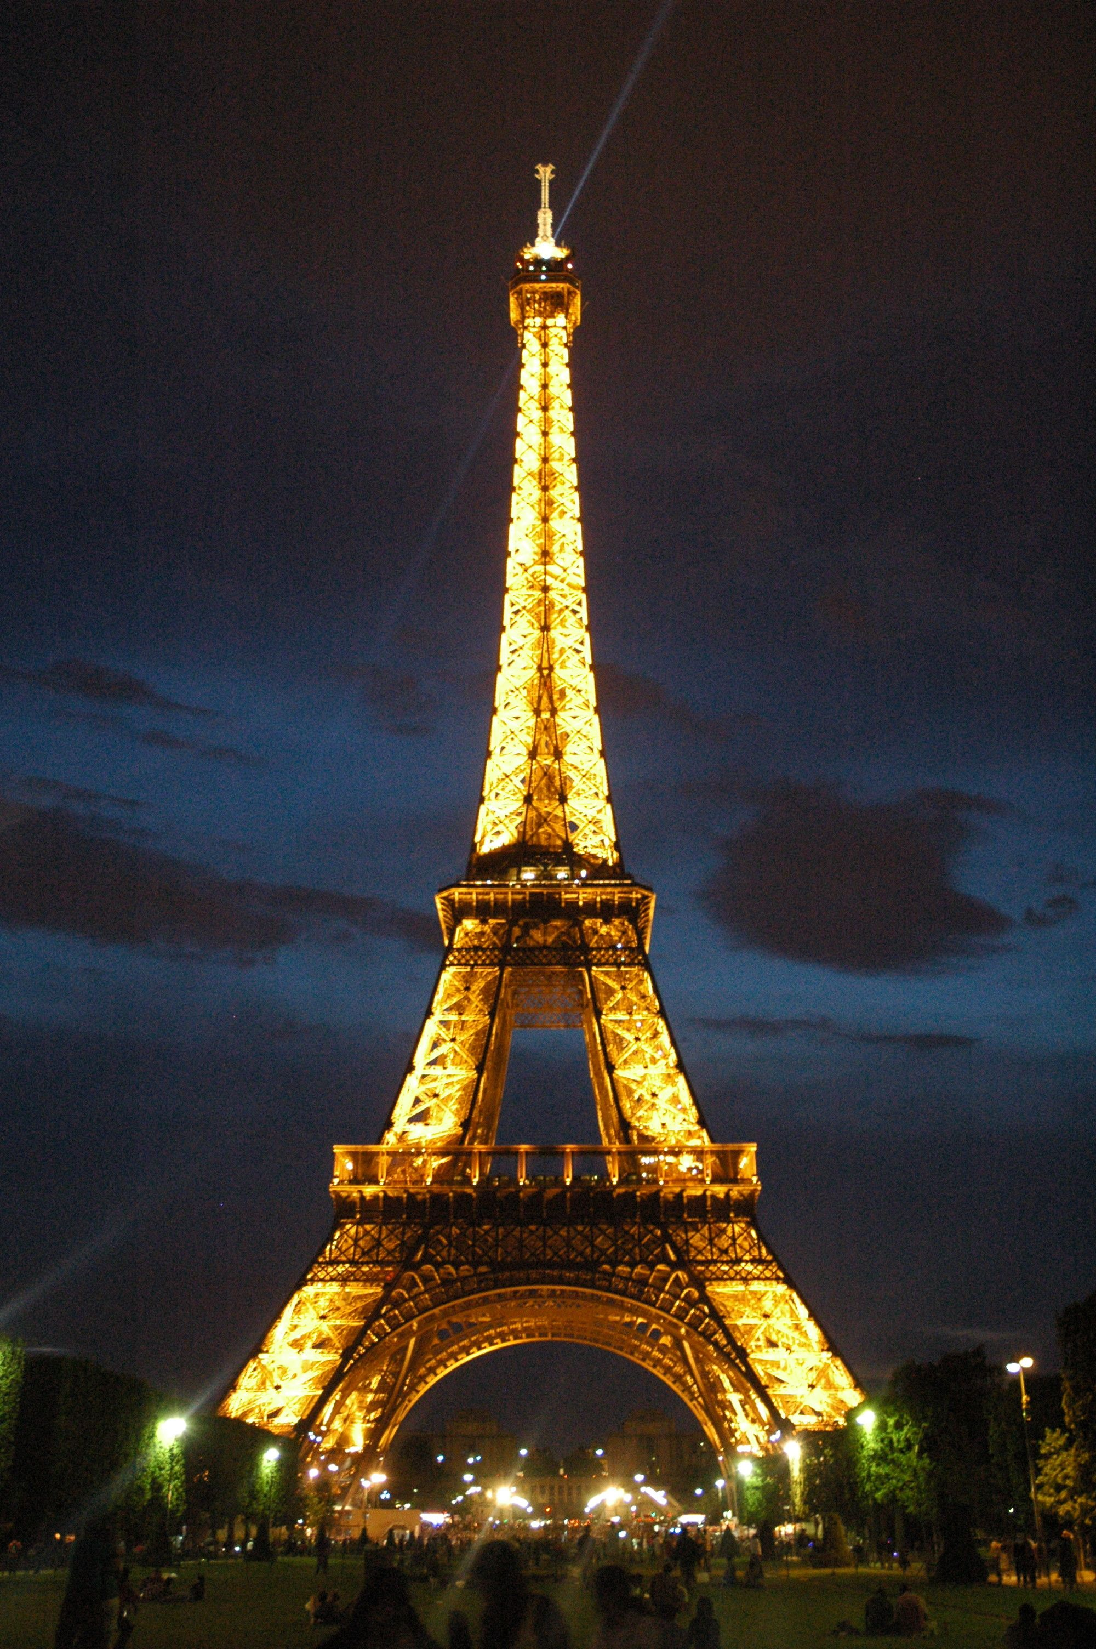
Introduction
In-depth analysis of Airbnb data for Paris through visualizations using Python and Tableau, which would help Airbnb to increase its revenue.
The dataset is sourced from website http://insideairbnb.com/get-the-data.html and data was compiled on 05 February 2019 (Inside Airbnb).
We used the listings.csv dataset which consists of information and metrics for listings in Paris and reviews.csv consists of review data and listing ID for the years 2009 – 2019.

Slide 3

Aim
Increase in the revenue of Airbnb depends on the revenue earned by the hosts as Airbnb charges 3%, only once the reservation is completed (Airbnb Financials). Hence, the month when the host lists, the location where he lists, and the type of property he lists matter!
Analysis to one neighborhood based on the average and median price of that neighborhood and the competition in that neighborhood. Then, we followed it with analyzing the highly correlated features in that neighborhood and selecting the time to list the property.

Slide 4
DESIGN PRINCIPLES
Color: Color can be expressed in many ways and is used to attract the viewers’ attention. Most of the graphs have the bars in blue.
Form: We have used bar charts for most of the figures as they are easier for interpretation and comparison.
Other pre-attentive visual properties like intensity, length and the width of the figure are also focused on the graphs below.
We used Tufte's Design Principles to ensure high graphical integrity by showing that the labels are clear and detailed. So, all the figures have a title, labels for x, y and an interactive legend.

Slide 5
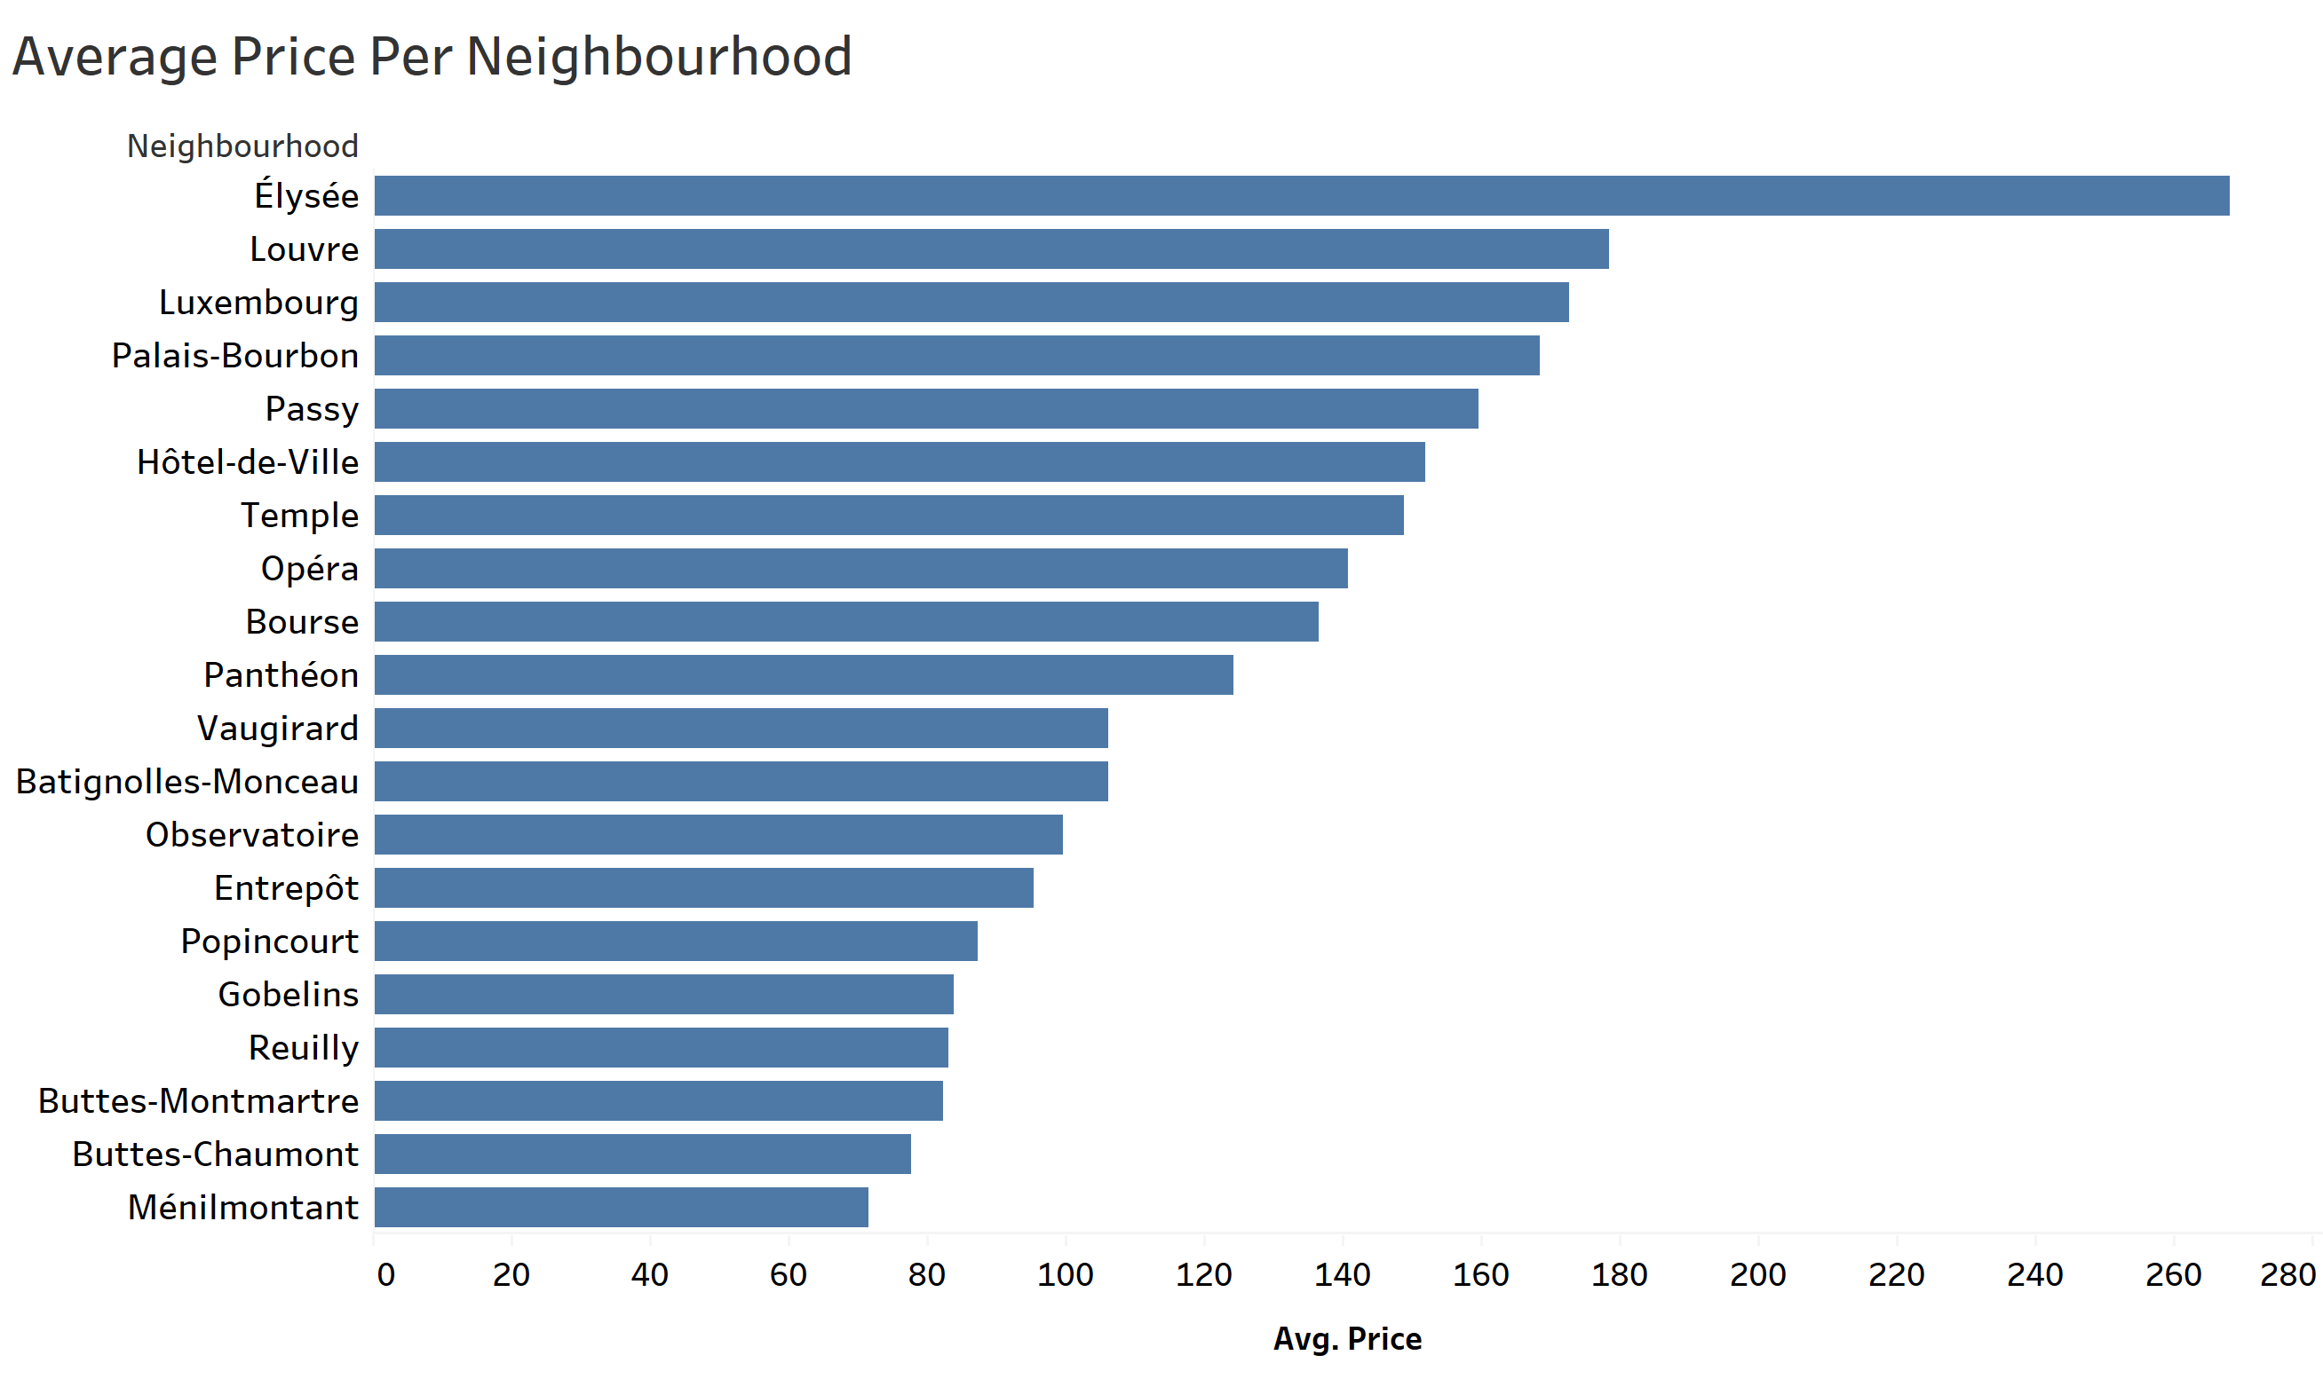
Analysis 1- Where to list?
Average price per neighborhood – Highest in Elysee.
Figure 1

Slide 6
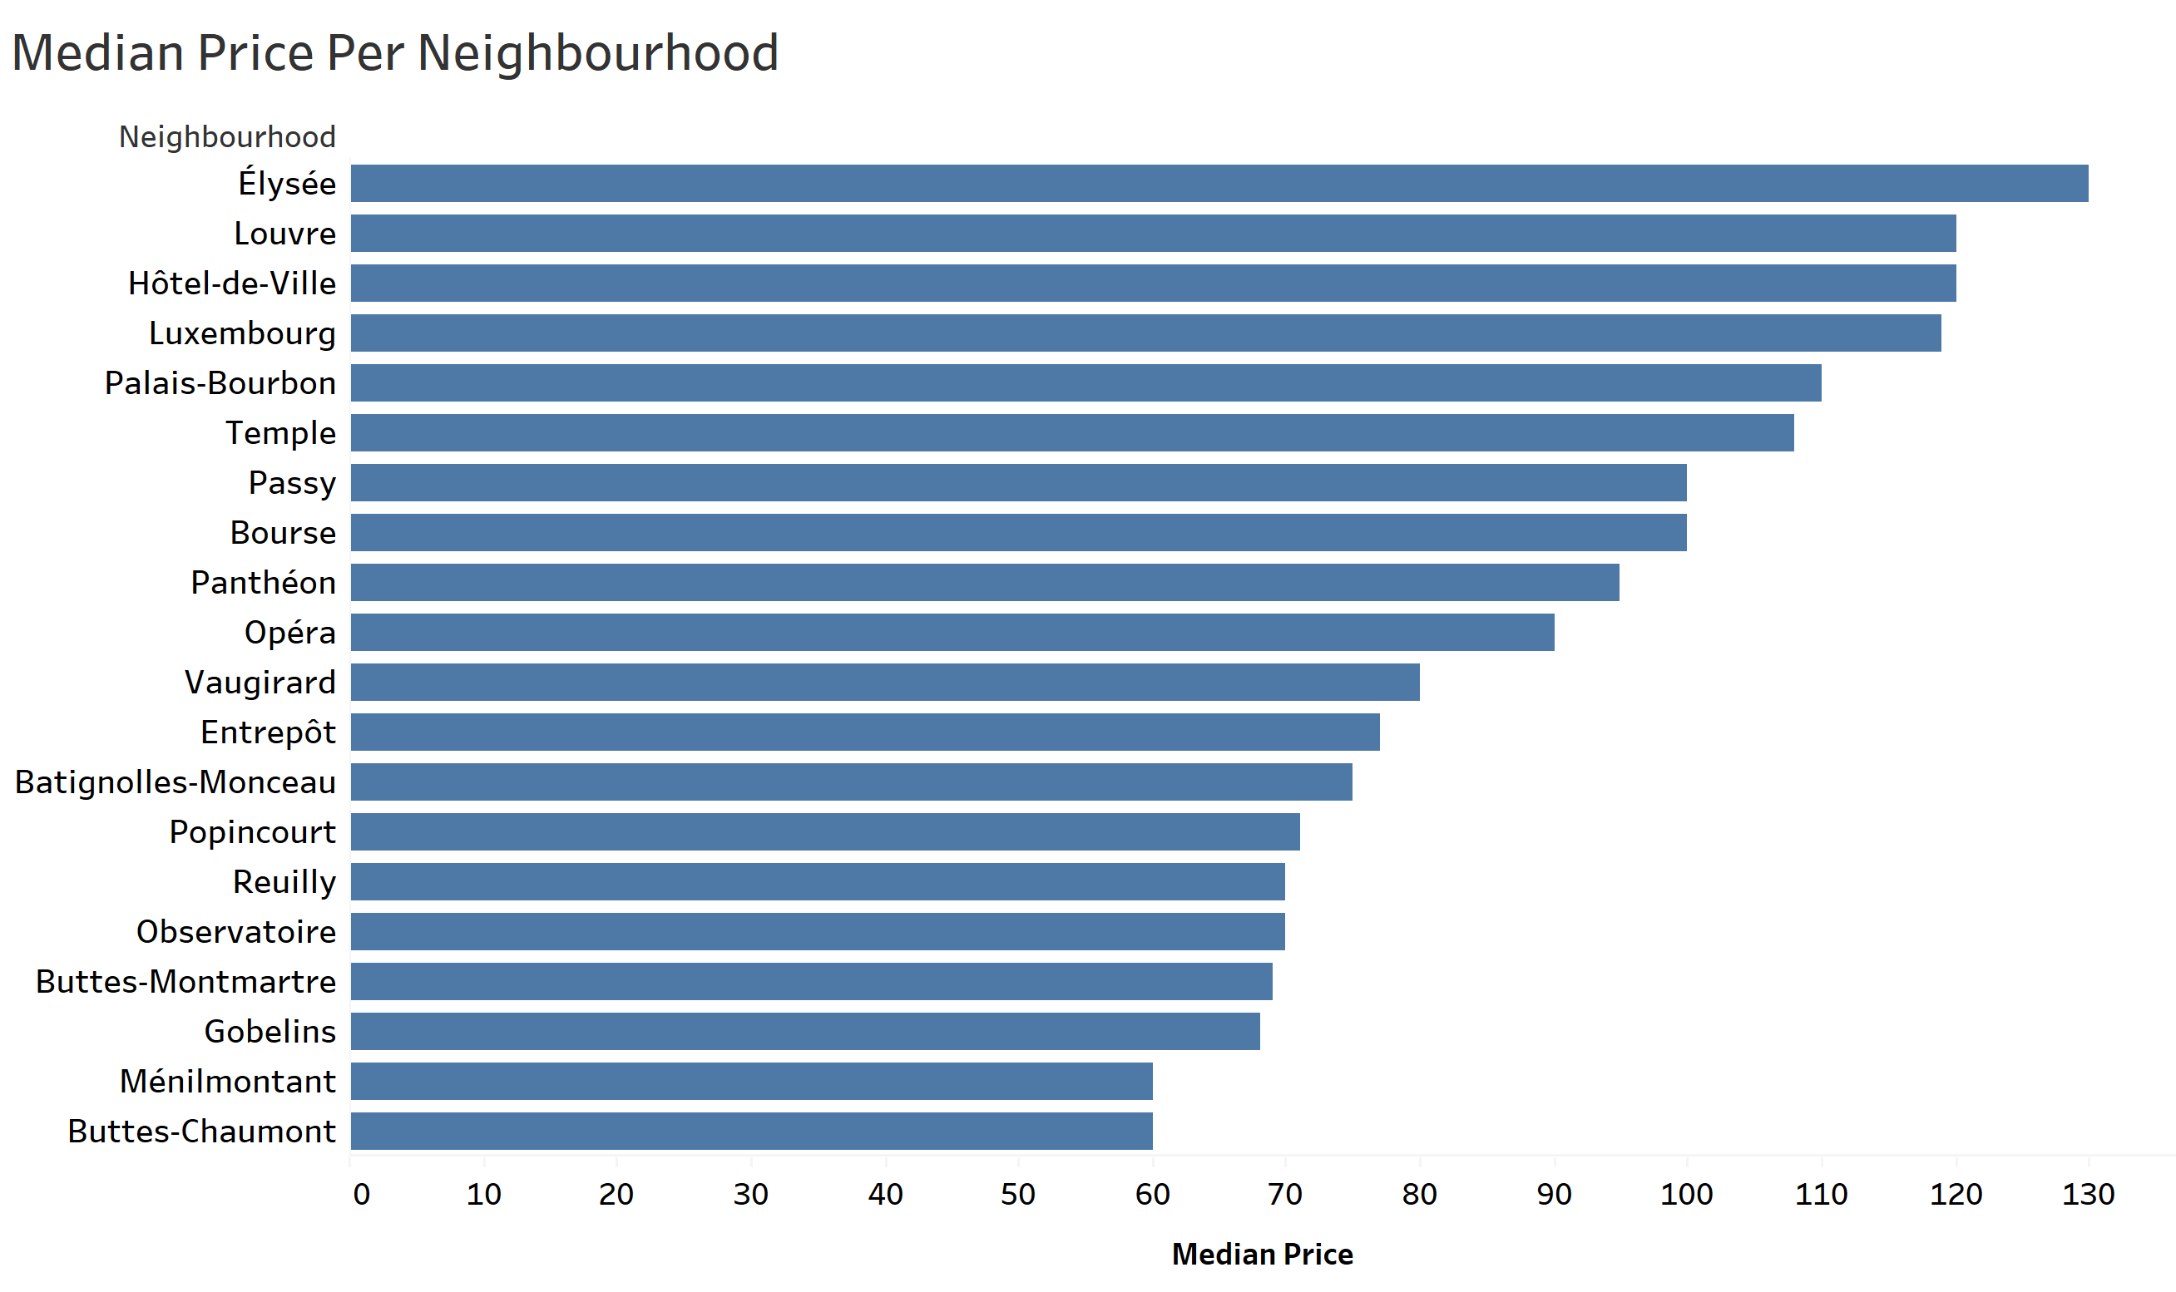
Median price per neighborhood: The median price is highest in Elysee.
From the figures 1 and 2, we can say that half of the listings in Elysee are significantly priced higher.
Figure 2

Slide 7
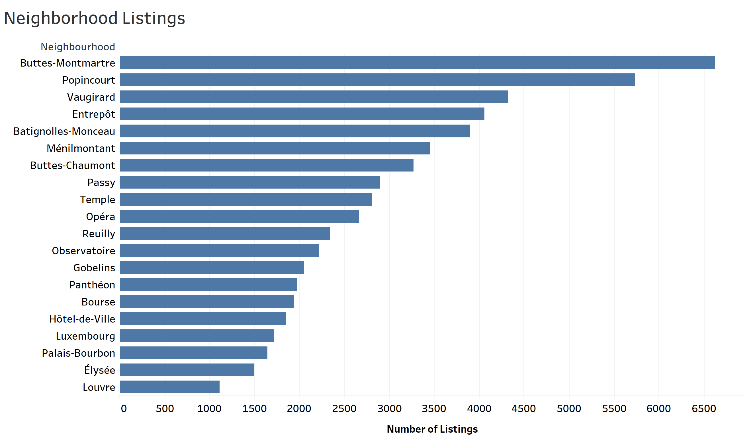
Competitive neighborhoods- The number of listings is highest in Buttes-Montmartre, and the listings in Elysee are quite low. From this we can say that the competition in Elysee area is less.
So from the figures 1, 2, and 3 we can infer that in Elysee the host can exploit the market as average price is high and competition is less.
Figure 3

Slide 8
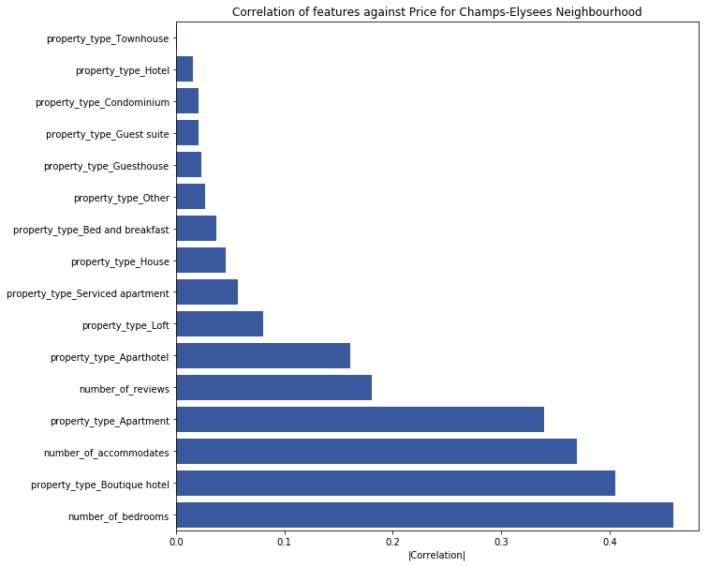
Analysis II- Factors to consider while listing
To increase the revenue, the host should consider the factors which affect price the most.
From this correlation graph, we see that number of bedrooms, property type and number of accommodates are the highly correlated features with price. Hence, after selecting the neighborhood, the host can optimize the price by selecting the right features.
Figure 4

Slide 9
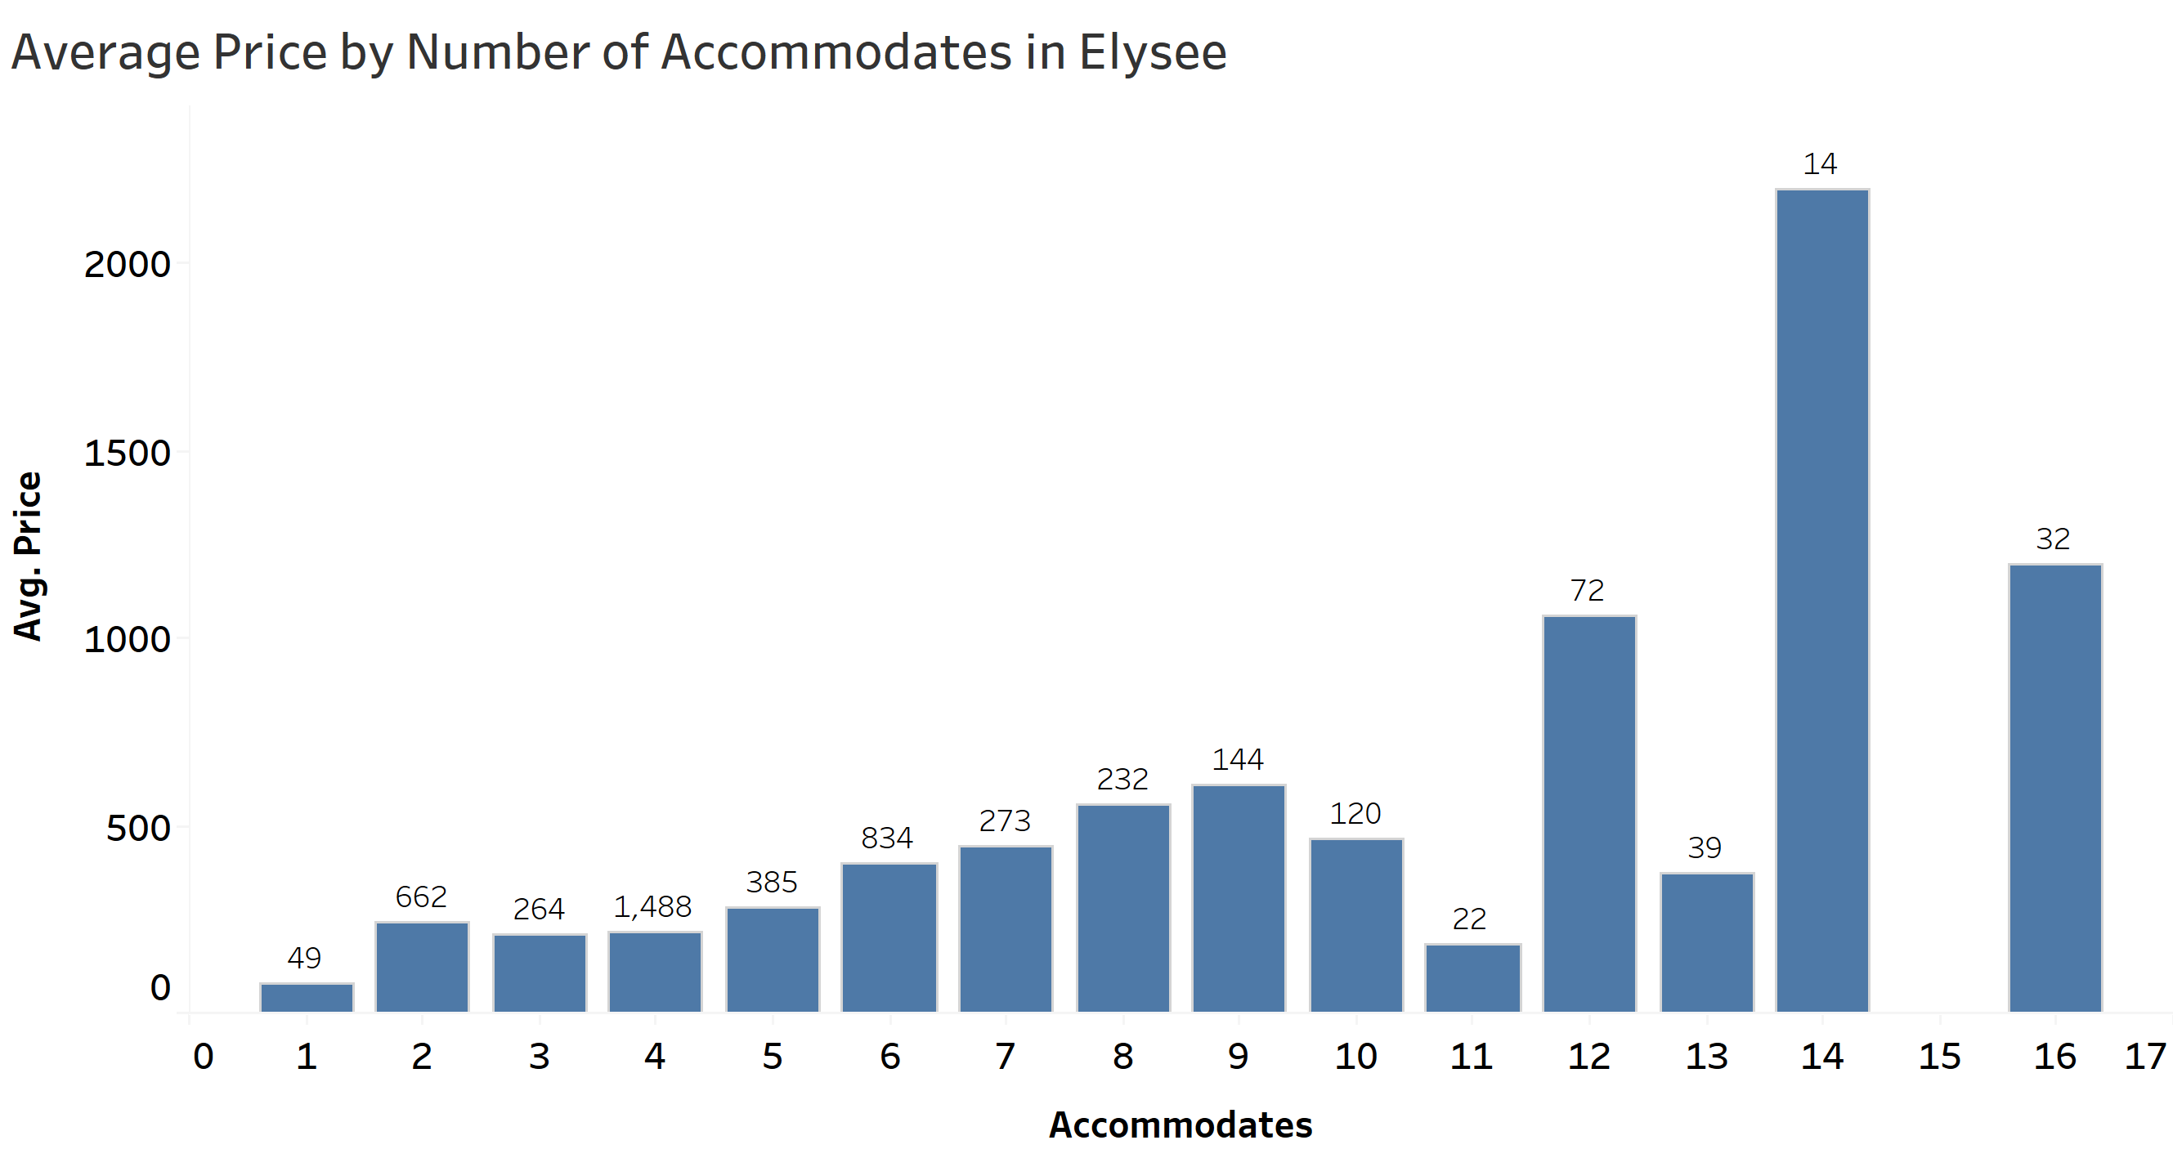
Represents the average price per number of accommodates in the Elysee neighborhood with the listings at the top of each bar.
The average price of the listing is varying after the 10 accommodates and the number of listings is less as compared to that of lower number of accommodates.
Figure 5

Slide 10
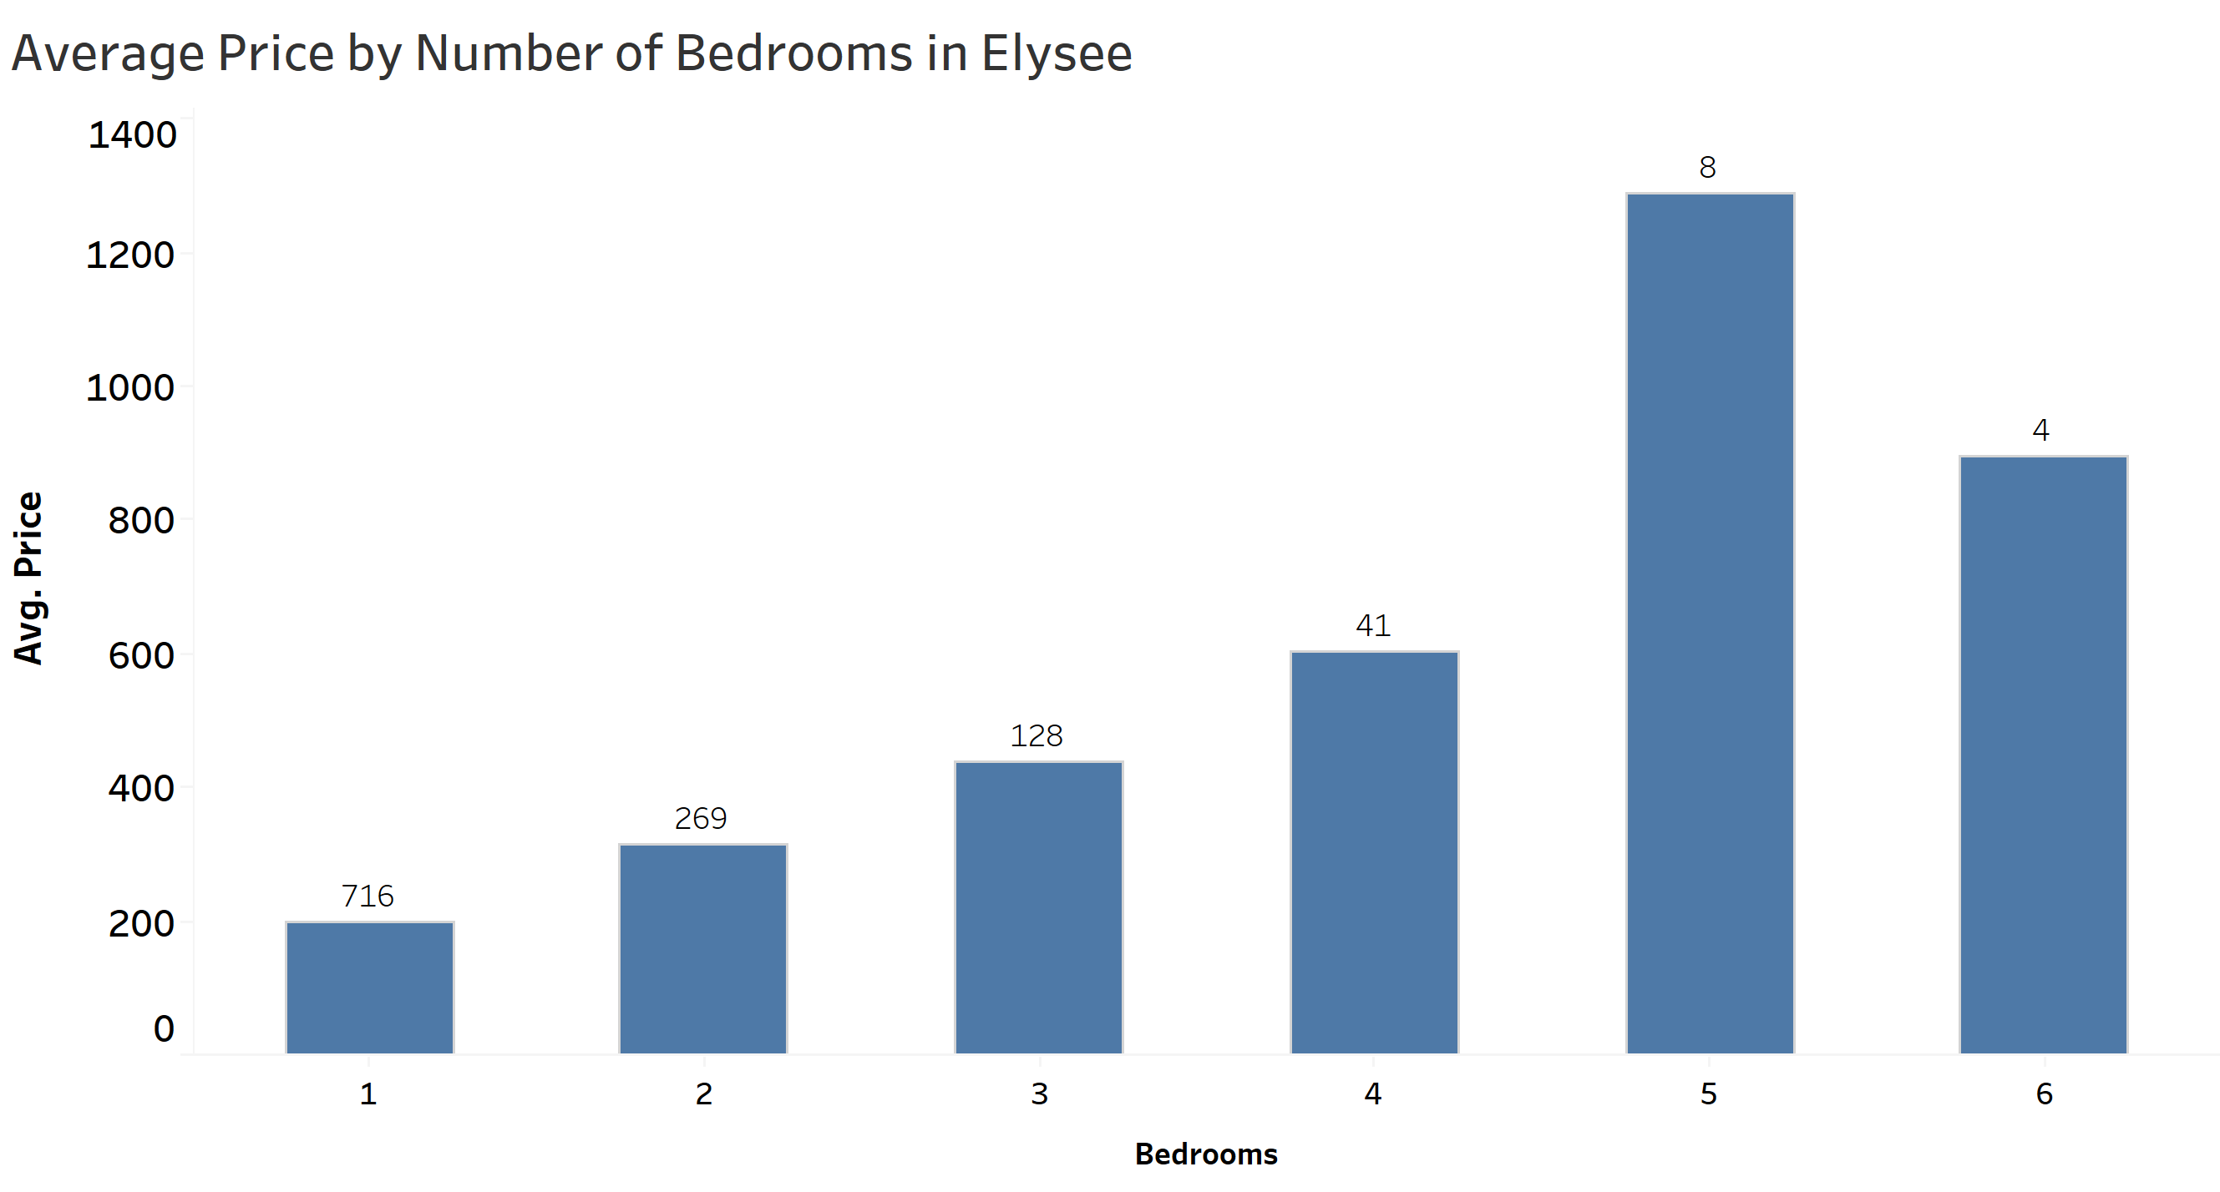
This graph represents the average price of listings per number of bedrooms in Elysee.
From Figure 5 and 6 we can suggest the host should allow for varying number of accommodates from 11 to 14 as he can charge a higher price and the competition is also low for those number of accommodates as the number of listings are low and can keep 5 bedrooms to be able to charge a higher price.
Figure 6

Slide 11
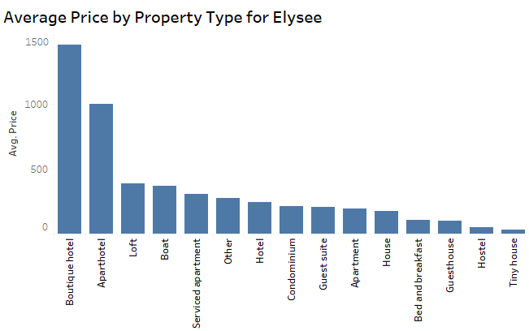
This graph shows, in Elysee, Apartment hotels and Boutique hotels are priced the highest.
Figure 7

Slide 12
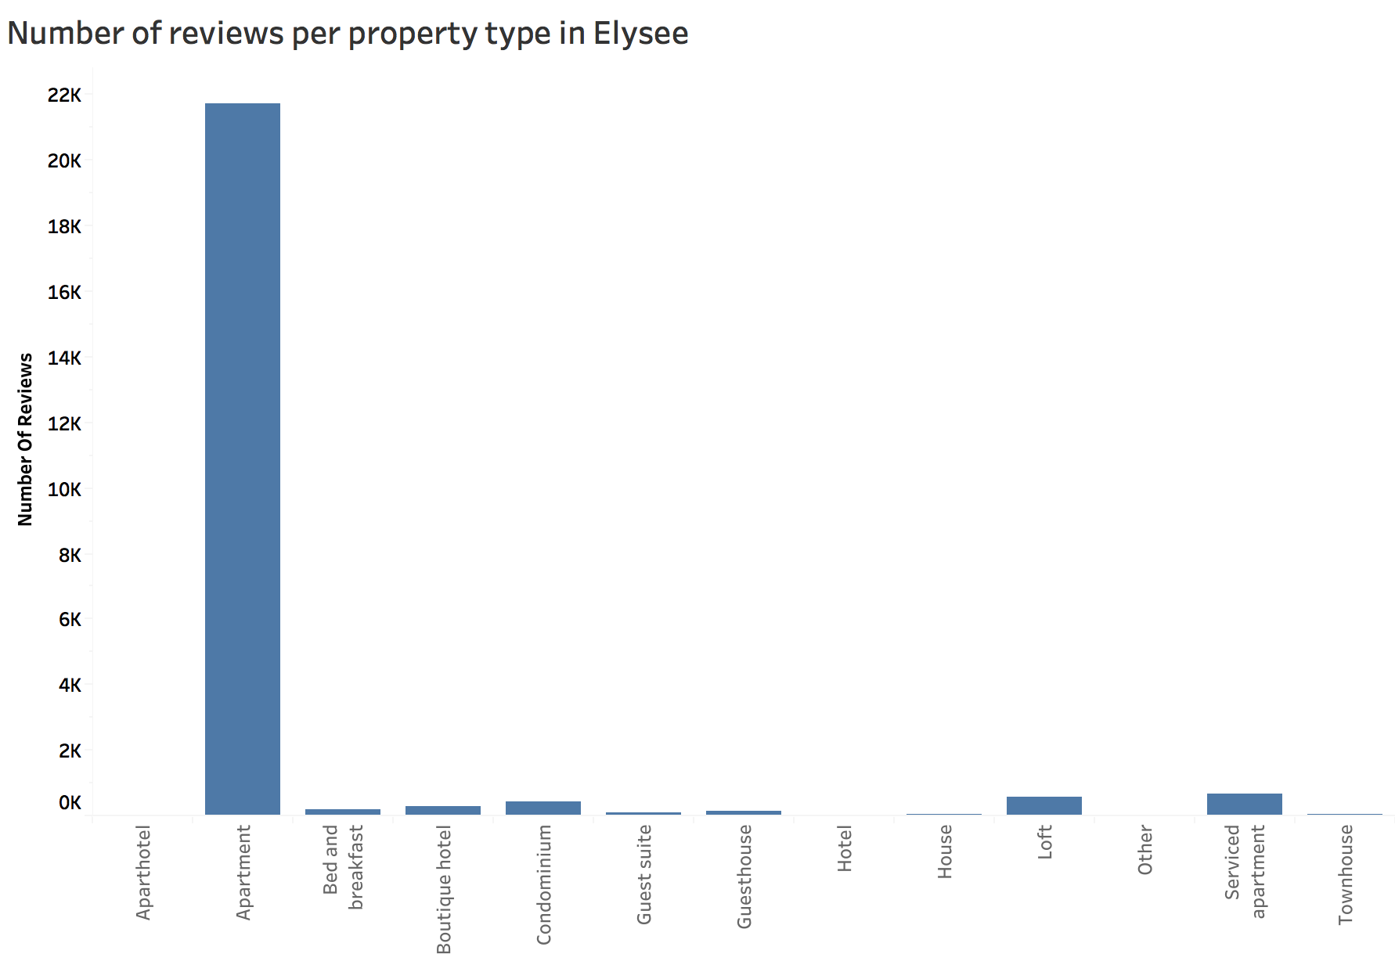
This graph shows that the Apartments are the highest in demand and figure 7 shows low average price for them. Hence, the host can charge a comparatively higher price based on these two factors.
Figure 8

Slide 13
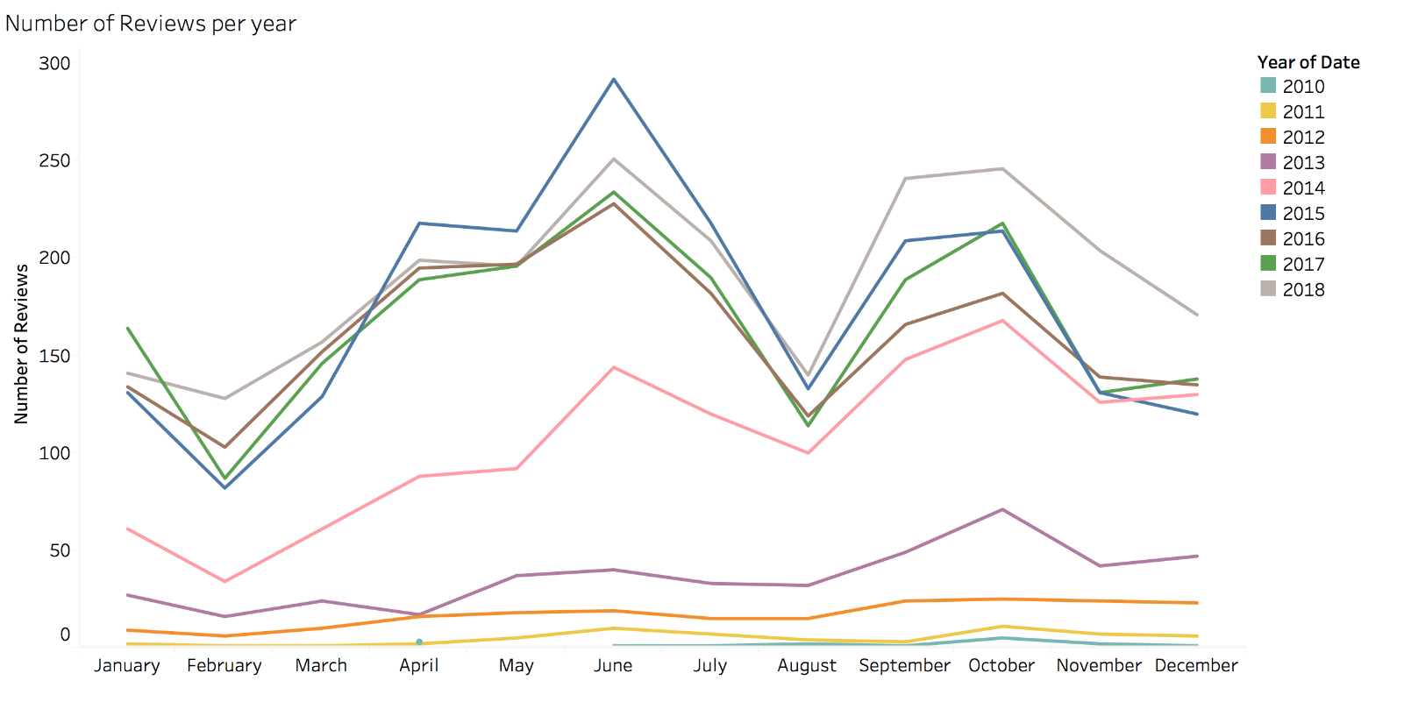
Analysis III- When to list the property
Considering the number of reviews in each month as a proxy for the demand of listings in that month.
The number of comments shows a similar pattern in each month of recent years, particularly after 2014. We can say that the demand for Elysee listings are highest during the month of June. So, the host in Elysee should list his place in June.
Figure 9

Slide 14
challenges
Assumptions had to be made for analysis. Since, we did not have the previous year bookings data, we used “number of reviews” feature as a proxy for demand of listings. Also, to obtain number of reviews for each month, we had to combine two data sets.

Slide 15

Conclusions
We solved the business problem by choosing the neighborhood by analyzing the average and median price and considering the competitiveness in that neighborhood.
We found Elysee to be a neighborhood where a host could list. Then, we obtained the factors which were highly correlated with price for considering the features to be included in the listing.
Our analysis convey the ways a host can maximize his or her revenue which in turn would increase the revenue of Airbnb.

Slide 16





Speakers
Divya Puraswani
Sai Chaitanya Tolem
Shubh Johri
Aarathi Nadathur
Sameer Rajput

Slide 17
THANK YOU

Slide 18
SPEAKERS

